Slide 1
Consumer Financial Protection Bureau (CFPB) Consumer Complaints Analysis
Group 2:
Nupur Pathak, Revathi Boopathi, Sree Divya Cheerla, Vani Bhat

Slide 2
Agenda
Introduction
Project Objective
Datasets
Stages of Implementation
Data Cleaning and Wrangling
Data Join
Visualizations
Dashboards
Use Case Demonstration
Conclusion and Future Scope

Slide 3
Introduction
CFPB is a U.S. government agency dedicated to making sure you are treated fairly by banks, lenders and other financial institutions.
Consumer complaint database is CFPB’s database of financial product and service complaints to see how various financial companies respond to consumers.
These complaints act as a powerful tool to provide insights for the companies to identify whether the consumers are satisfied with their product and service offerings.
Problem Statement:
From the ‘Consumer Complaint Database’ we can infer that many consumers are dissatisfied with the banking services offered by their company.
This is reflected from the number of complaints raised by the consumers. It is important to analyse from both consumer and the company’s perspective as to why, what and where the issues are being faced and address them appropriately.

Slide 4
Agenda
Introduction
Project Objective
Datasets
Stages of Implementation
Data Cleaning and Wrangling
Data Join
Visualizations
Dashboards
Use Case Demonstration
Conclusion and Future Scope

Slide 5
Project Objective
The main objective of this project is to identify the major areas of the banking/ financial product services where the consumers are facing maximum issues and address them for the respective product categories offered by the companies.
Our analysis can help CFPB to regulate consumer financial products and services and also educate and empower consumers to make informed financial decisions.
Key Questions:
What are the products/sub-products with maximum consumer complaints ?
What are the prominent Issues faced by consumers ?
Which states have seen the highest number of complaints registered ?
Is there a correlation between number of complaints and population density ?
What mode do consumers prefer to log their complaints ?
What are the top companies with the highest complaints and how are the companies responding to registered complaints?
What actions companies need to take to improve the consumer experience?

Slide 6
Agenda
Introduction
Project Objective
Datasets
Stages of Implementation
Data Cleaning and Wrangling
Data Join
Visualizations
Dashboards
Use Case Demonstration
Conclusion and Future Scope

Slide 7
Datasets
Dataset - I
Dataset - II

Slide 8
Agenda
Introduction
Project Objective
Datasets
Stages of Implementation
Data Cleaning and Wrangling
Data Join
Visualizations
Dashboards
Use Case Demonstration
Conclusion and Future Scope

Slide 9
Data Cleaning and Wrangling
Data pre-processing and wrangling has been done in Jupyter Notebook and tableau. Below are the preprocessing steps incorporated.
Converted the ‘Date Sent’ and ‘Date Received’ column of the data set to the appropriate format yyyy-mm-dd
Dataset is filtered for year >2018
Dropped the ‘Consumer Narrative’ column in the dataset as this is a text heavy field which had led to the slowness of the tableau desktop
Modified the column names in Tableau to adhere with the standards
Ensured the null values are handled

Slide 10
Agenda
Introduction
Project Objective
Datasets
Stages of Implementation
Data Cleaning and Wrangling
Data Join
Visualizations
Dashboards
Use Case Demonstration
Conclusion and Future Scope

Slide 11
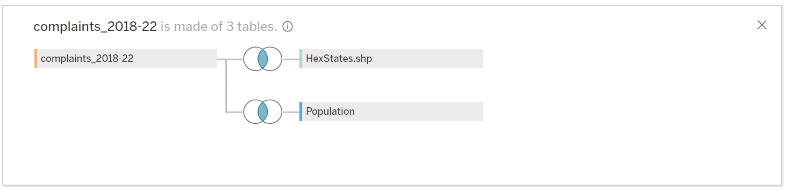
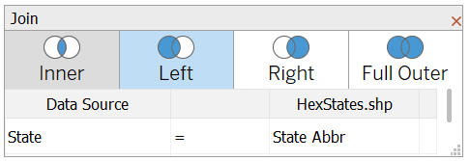
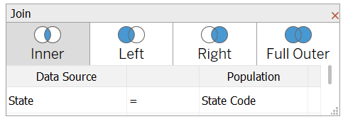
Data Join
We have performed an inner join operation of the Consumer Complaint dataset with the US population dataset and Hex Spatial file( to help generate hex maps for US states) with the intention of bringing out the state wise correlation between the number of complaints registered and the population density.
Spatial File: Used to generate Hex Maps for United States
Population Dataset: Used to correlate complaints registered and population density

Slide 12
Agenda
Introduction
Project Objective
Datasets
Stages of Implementation
Data Cleaning and Wrangling
Data Join
Visualizations
Dashboards
Use Case Demonstration
Conclusion and Future Scope

Slide 13
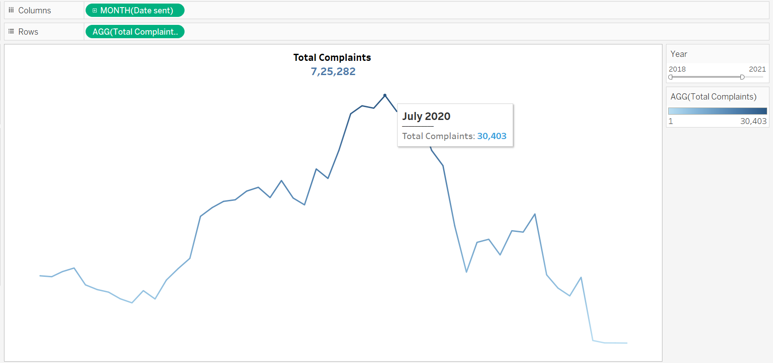
Total Complaints
Type of chart: Line

Slide 14
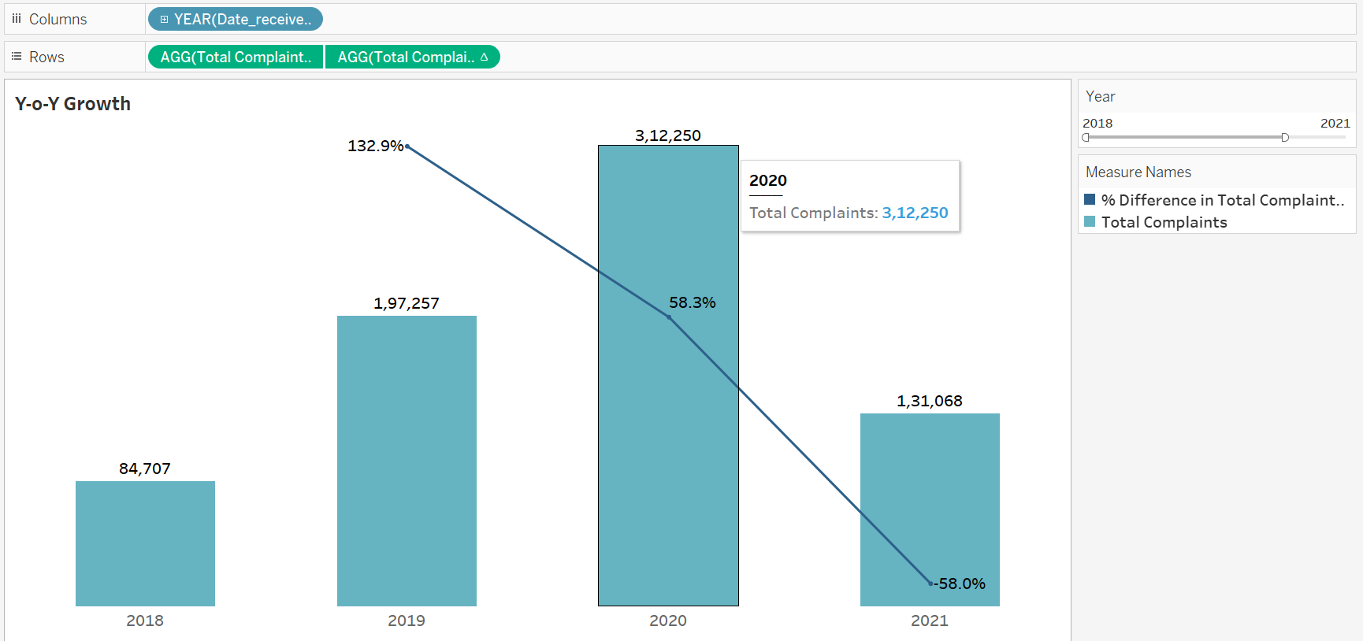
Y-o-Y Growth
Type of chart: Dual combination

Slide 15
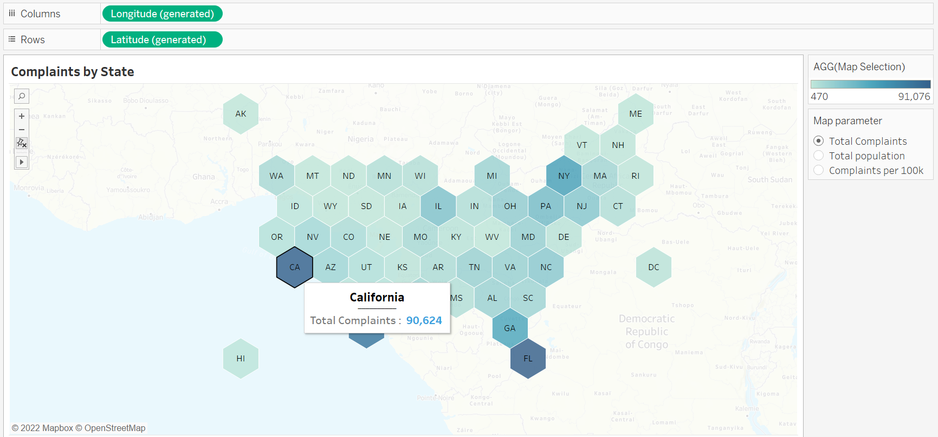
Complaints by State
Type of chart: Hex Maps

Slide 16
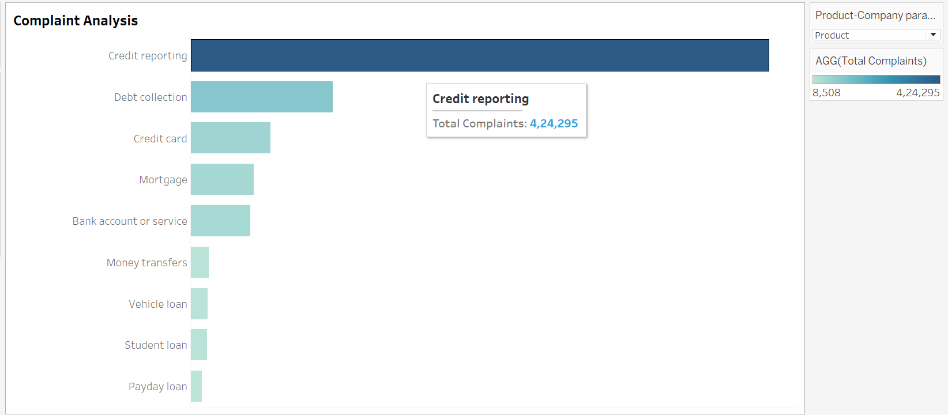
Complaint Analysis – By Product
Type of chart: Horizontal bars

Slide 17
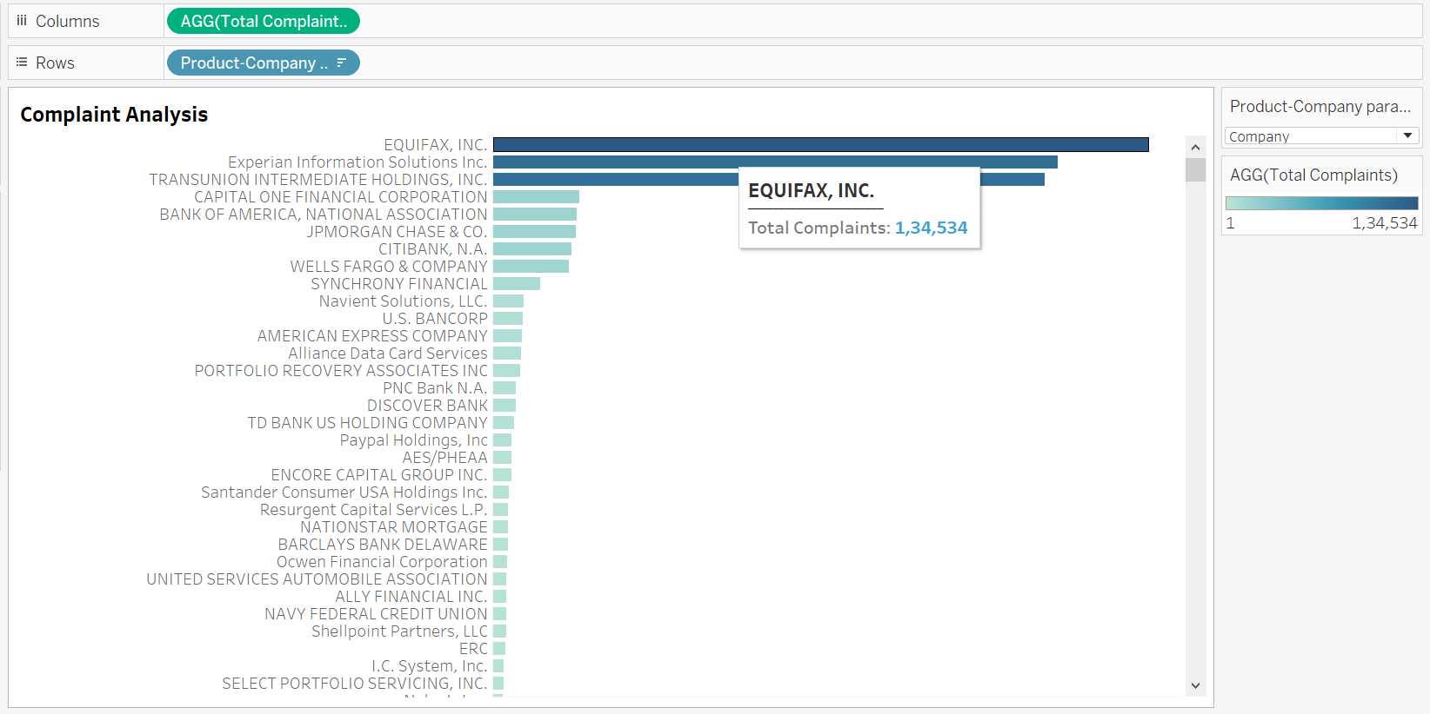
Complaint Analysis – By Company
Type of chart: Horizontal bars

Slide 18
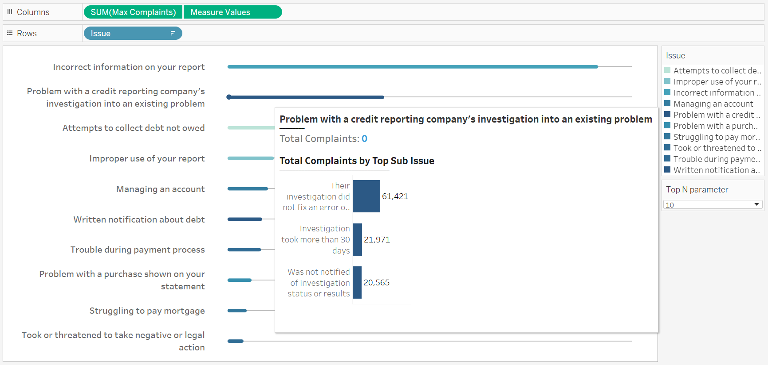
Complaints by Issue
Type of chart: Horizontal bars

Slide 19
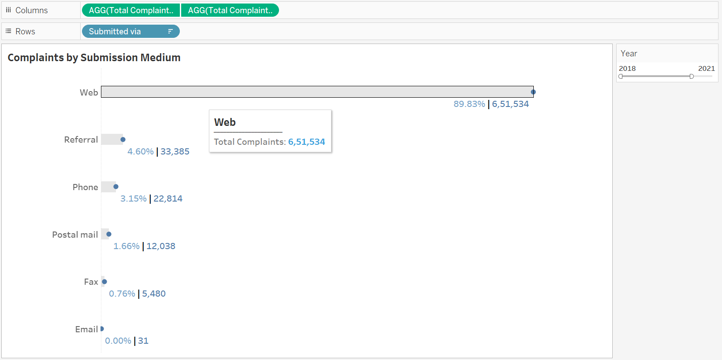
Complaints by Submission Medium
Type of chart: Horizontal bars and Scatter plots

Slide 20
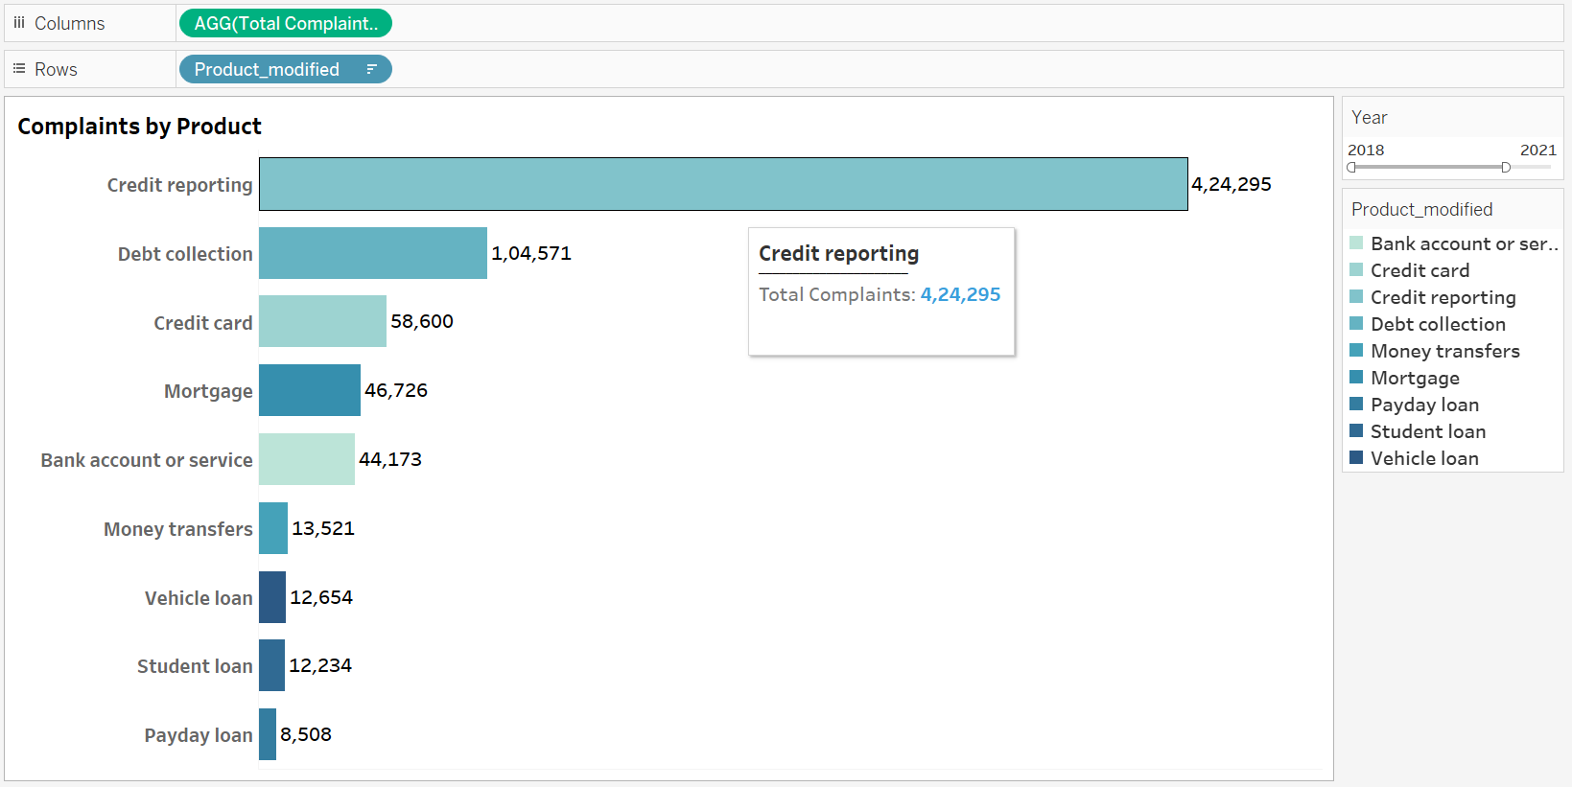
Total Complaints
Type of chart: Horizontal bars

Slide 21
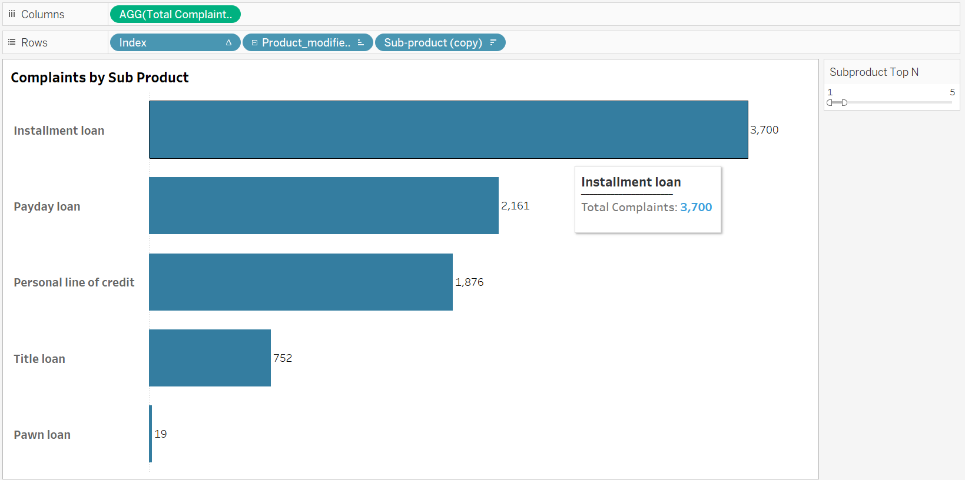
Complaints by Sub Product
Type of chart: Horizontal bars

Slide 22
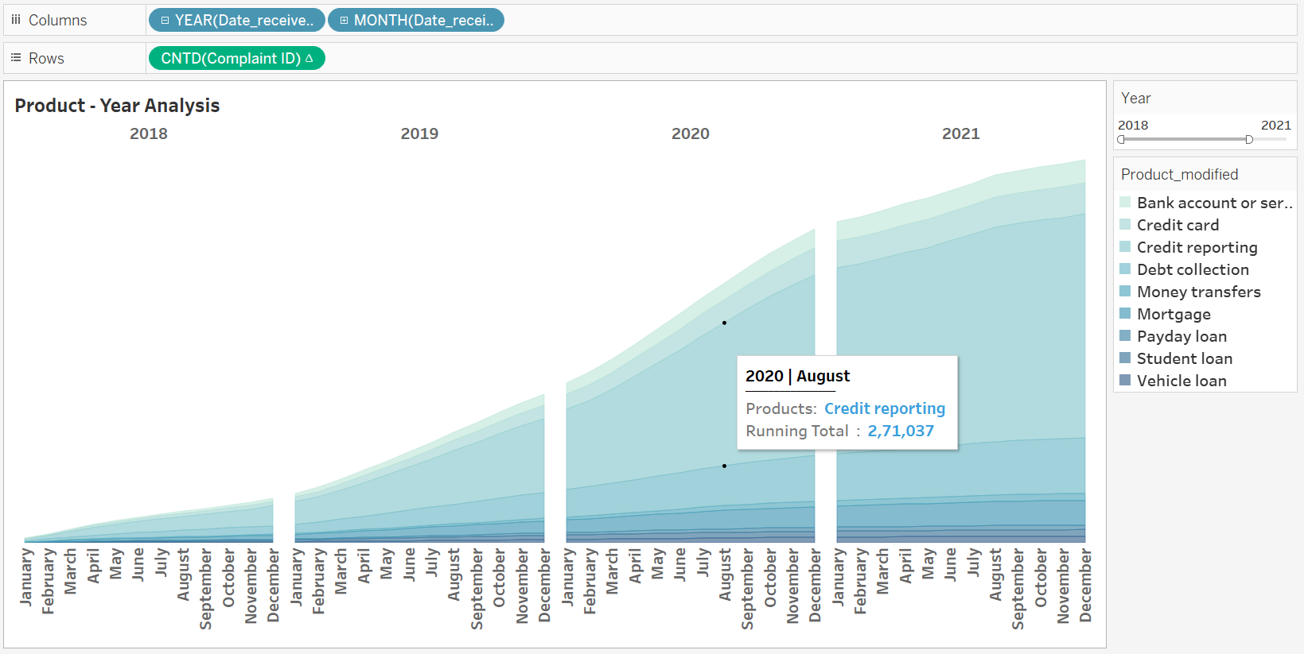
Product – Year Analysis
Type of chart: Area

Slide 23
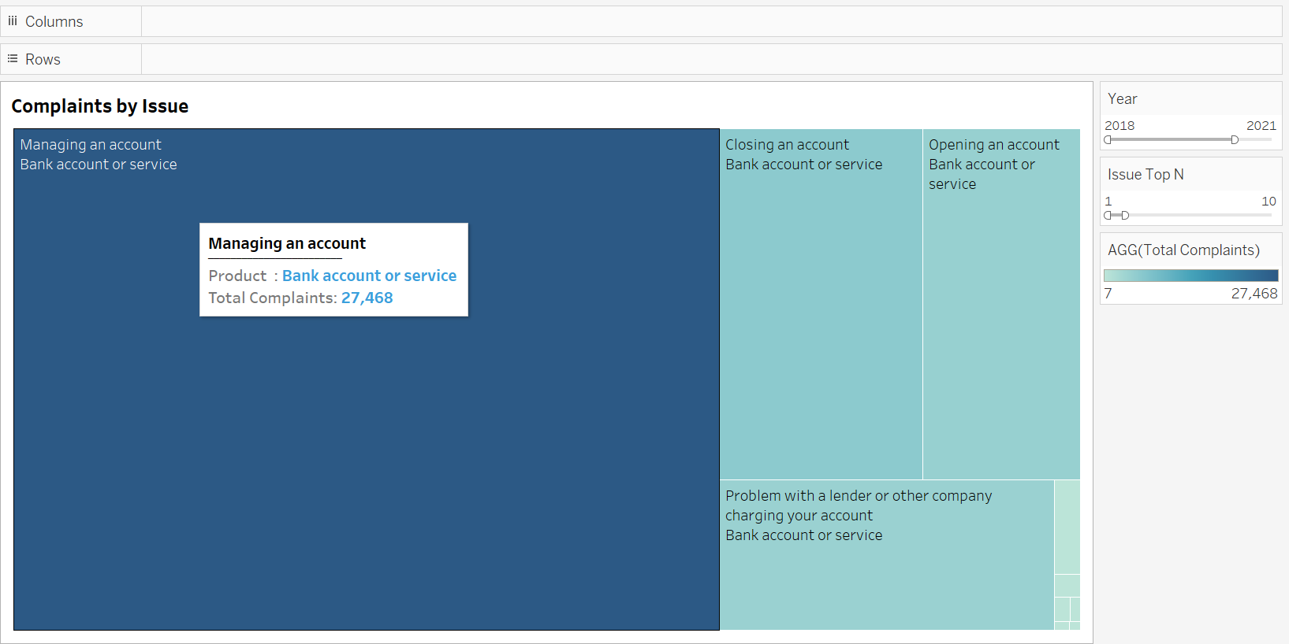
Complaints by Issue
Type of chart: Treemaps

Slide 24
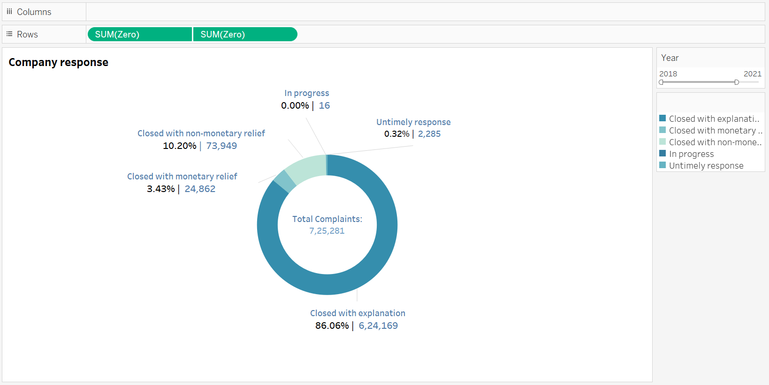
Company Response
Type of chart: Doughnut

Slide 25
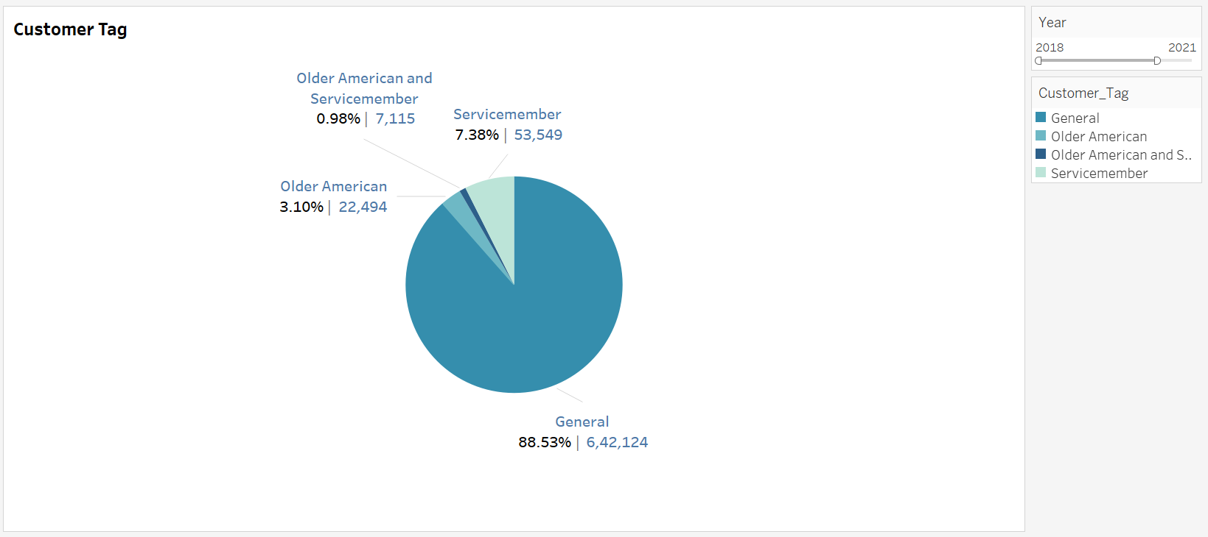
consumer Tag
Type of chart: Pie

Slide 26
Agenda
Introduction
Project Objective
Datasets
Stages of Implementation
Data Cleaning and Wrangling
Data Join
Visualizations
Dashboards
Use Case Demonstration
Conclusion and Future Scope

Slide 27
Dashboard
We have come up with 4 dashboards to provide information at glance.
Executive summary dashboard
Product analysis dashboard
Company product analysis
Company response analysis

Slide 28
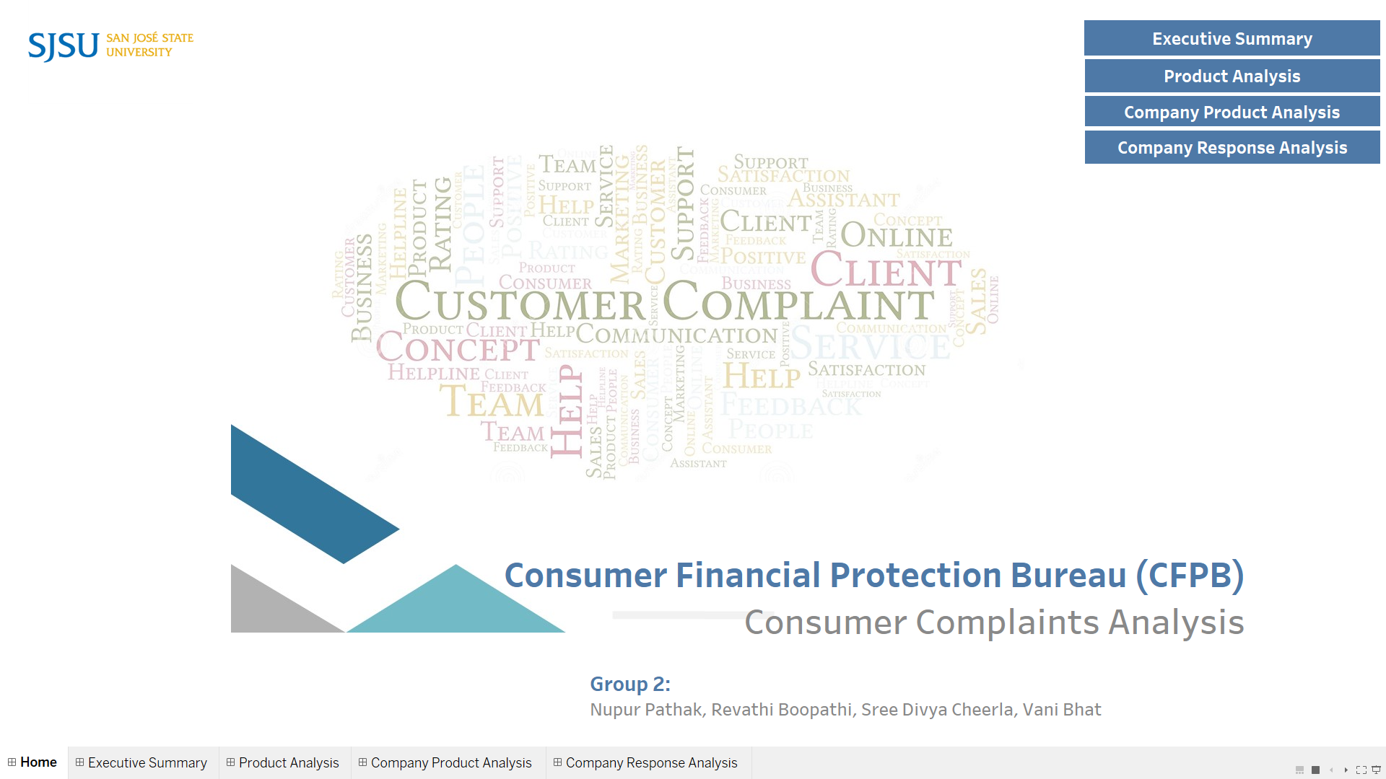
Use Case Demonstration

Slide 29
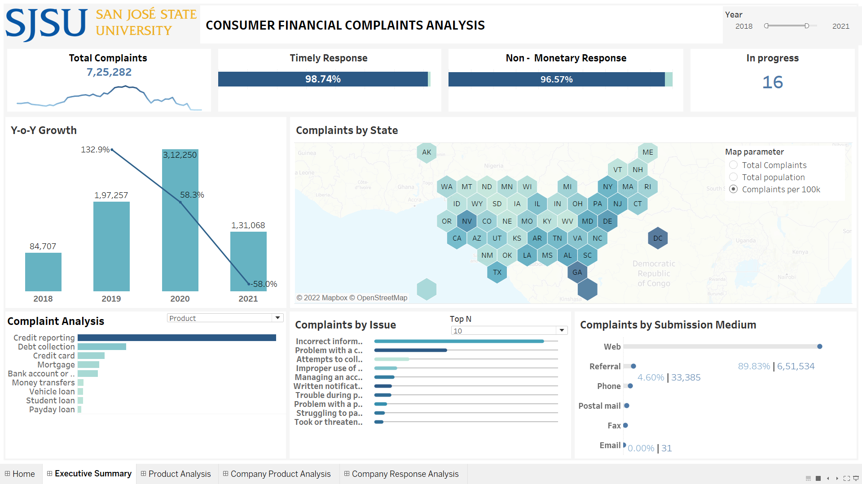
Dashboard

Slide 30
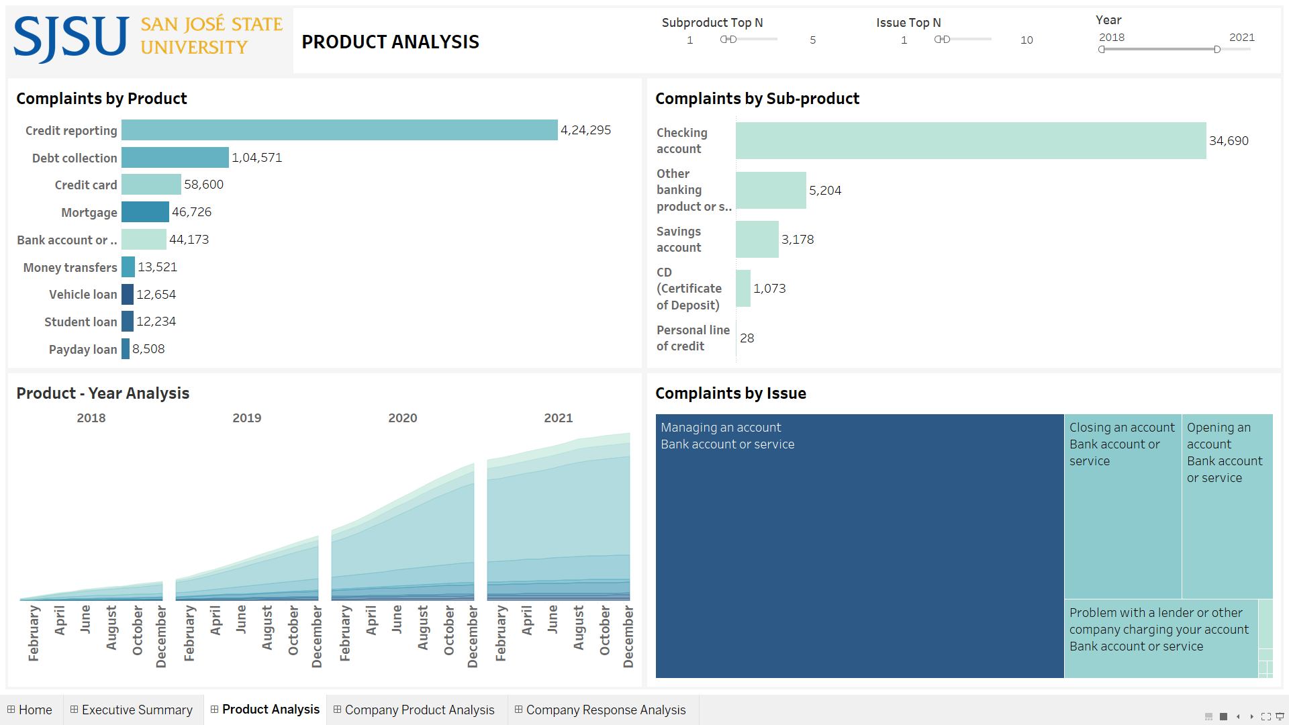
Dashboard

Slide 31
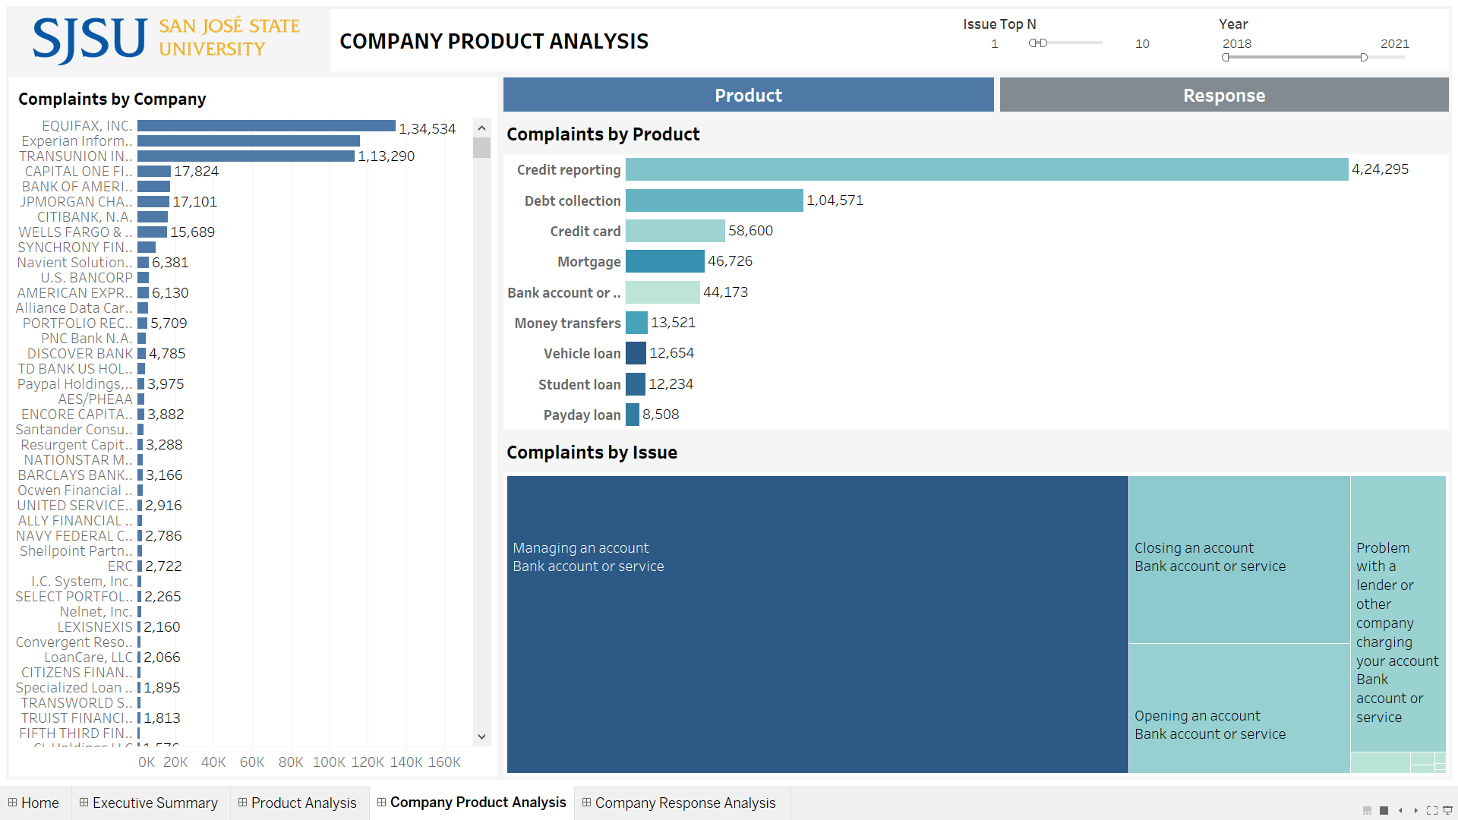
Dashboard

Slide 32
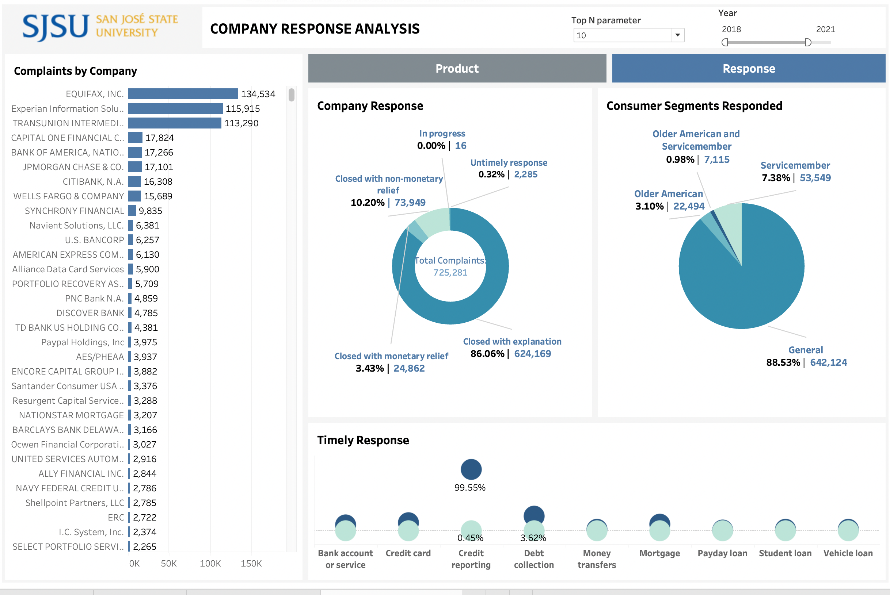

Slide 33
Agenda
Introduction
Project Objective
Datasets
Stages of Implementation
Data Cleaning and Wrangling
Data Join
Visualizations
Dashboards
Use Case Demonstration
Conclusion and Future Scope

Slide 34
Use Case Demonstration

Slide 35
Agenda
Introduction
Project Objective
Datasets
Stages of Implementation
Data Cleaning and Wrangling
Data Join
Visualizations
Dashboards
Use Case Demonstration
Conclusion and Future Scope

Slide 36
Conclusion and Future Scope
Based on the insights derived from the product analysis companies can improve their products and services and identify new offerings, thereby enhancing consumer experience.
Based on the geographical distribution analysis of complaints and population density, companies can analyse each state whether to increase consumer support as well as further investigate the issues in their products.
Consumer pain points can be inferred through sentiment analysis from the narratives of those consumers who have consented to give their feedback. This would help the companies to take necessary actions to bring down consumer financial complaints in future
Further analysis on consumer segments like Service members, Older American groups, etc. will help in better profiling of consumers and thereby providing targeted financial offers for impacted consumers

Slide 37

Thank you

